Slide 1
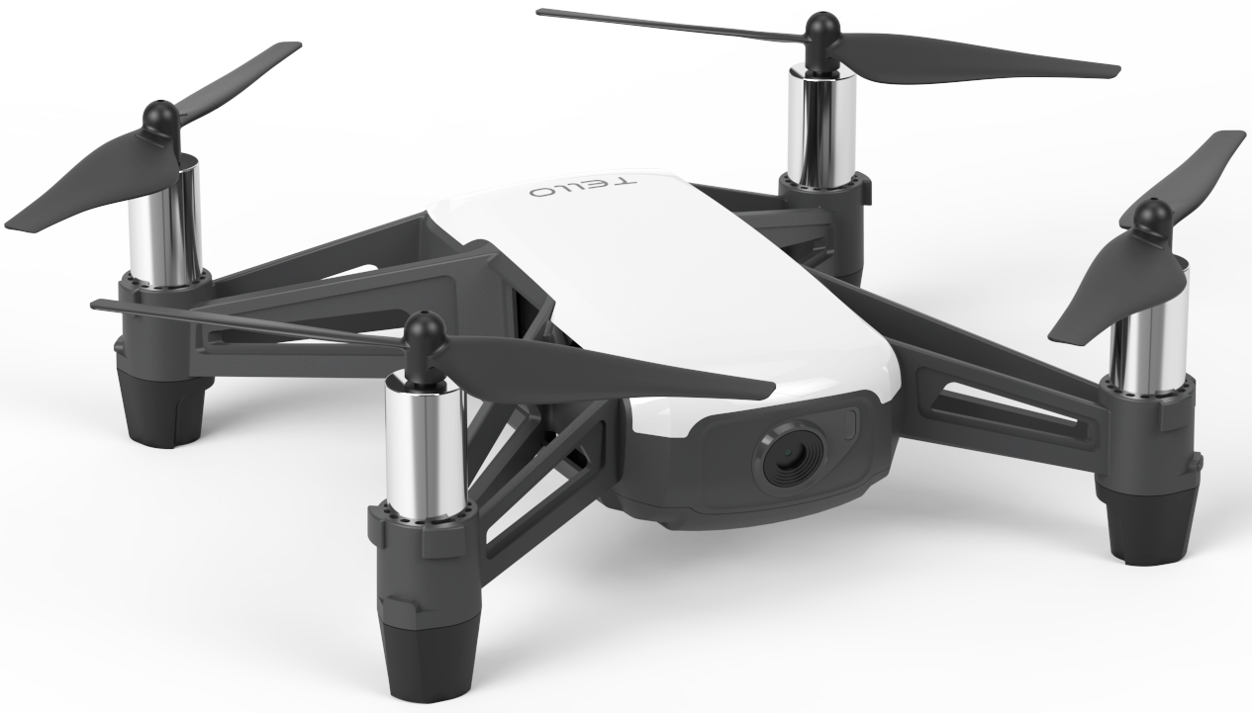
Autonomously Detect, Track and Land a UAV
Jonathan Edwards

Slide 2


Introduction
What is the goal?
To Detect, Track and Land on a marker.

Slide 3
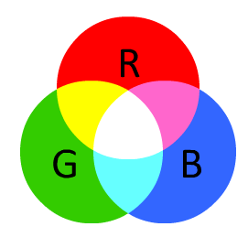
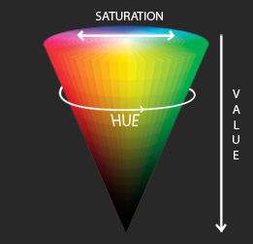
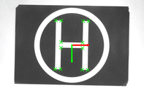
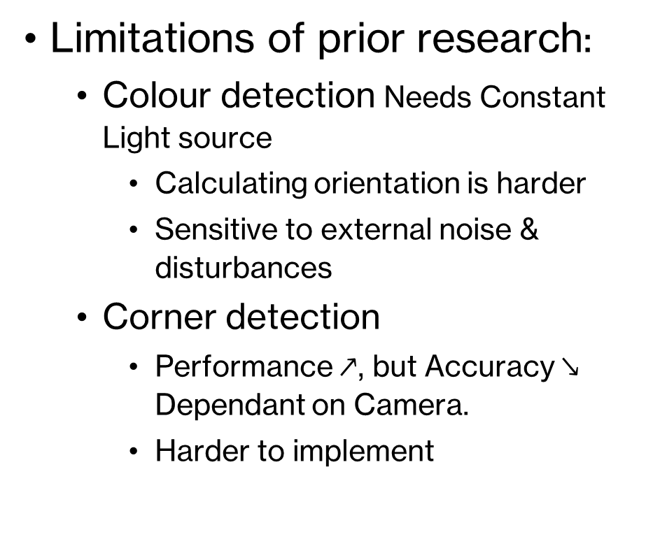
Background I
Limitations of prior research:
Colour detection Needs Constant Light source
Calculating orientation is harder
Sensitive to external noise & disturbances
Corner detection
Performance $↗$, but Accuracy$↘$ Dependant on Camera.
Harder to implement

Slide 4
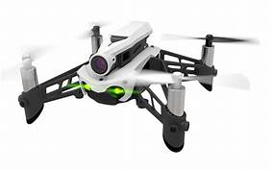
Background II
Limitations of prior research:
Template Matching
Accuracy was okay, Performance was very poor, 1.0 fps

Slide 5
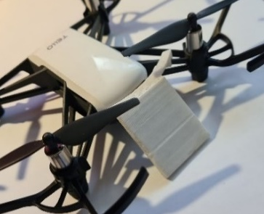
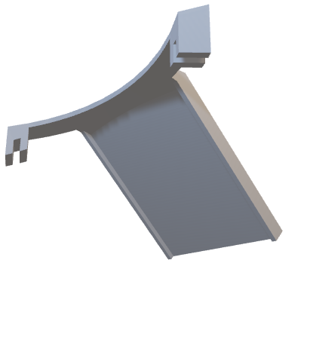
Solution
Hardware Upgrade
Brought a different drone.
Software Upgrade
Reimplemented Algorithm(s).
Added a mirror clip
So the camera could look vertically down.

Slide 6
Algorithms
Fiducial Marker + PID Controller

Slide 7
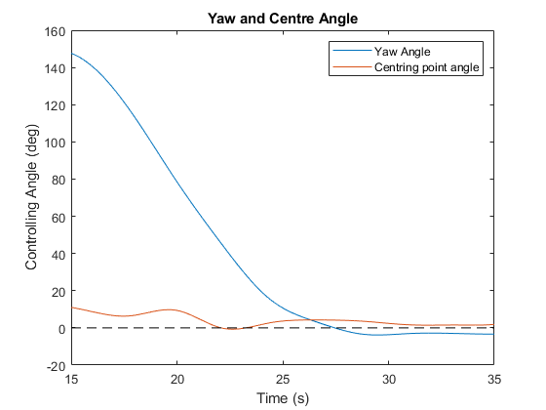
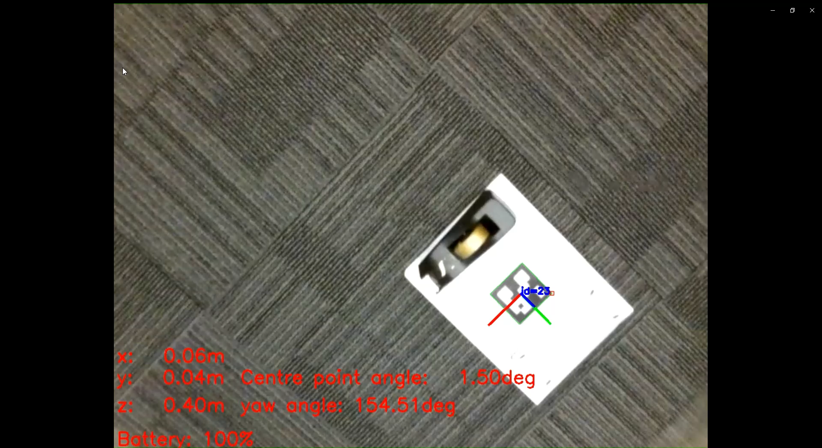
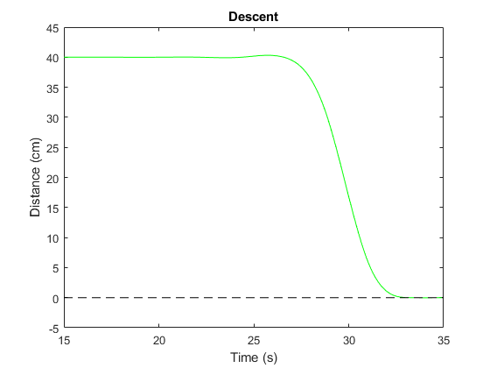

Slide 8
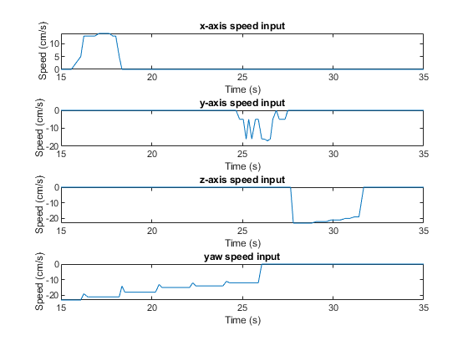
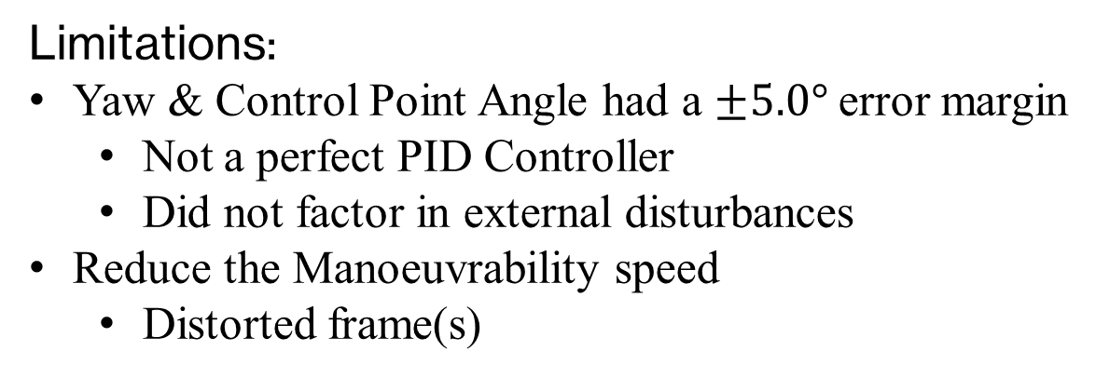
Results
Limitations:
Yaw & Control Point Angle had a $±5.0°$ error margin
Not a perfect PID Controller
Did not factor in external disturbances
Reduce the Manoeuvrability speed
Distorted frame(s)

Slide 9
Conclusion
By updating both the Hardware and Software, I managed to improve both Performance and Accuracy from a prior paper.

